Slide 1
PERSONAL PORTFOLIO MANAGEMENT DASHBOARD
Tracking Your Investments AND Assets AT A Glance
Presented by:
Keerthana B S 24SUUBECS0909
Keerthana D 24SUUBECS0911
Keerthana D 24SUUBECS0912
Keerthi V Meharwade 24SUUBECS0927
Kiran Mahantesh Biradar 24SUUBECS0937

Slide 2
TABLE OF CONTENT:
Section Number | Topic
1 | Problem Statement
2 | Introduction
3 | Proposed System
4 | Hardware and Software Requirements
5 | Algorithm
6 | System Architecture
7 | Dataflow Diagram
8 | Class Diagram
9 | Core Features & Project Analysis
10 | Snapshot
11 | Benefits And Implementation
12 | Advantages &Disadvantages
13 | Conclusion
14 | References

Slide 3
PROBLEM STATEMENT…!
In the modern world, individuals invest in multiple financial assets like stocks, mutual funds, gold, and real estate.
Managing these assets manually becomes time-consuming and confusing, especially when the values fluctuate frequently.
Most investors struggle to maintain accurate records of their investments and calculate returns manually.
Moreover, there is a lack of a unified platform that provides a complete view of an investor’s portfolio.
Without real-time tracking, it becomes difficult to analyze total profit, loss, or asset growth.
Hence, there is a strong need for a Personal Portfolio Management Dashboard that can simplify financial tracking and display all details in a single interface.

Slide 4
INTRODUCTION:
The Personal Portfolio Management Dashboard is a smart, interactive software system designed to help users manage and analyze their financial investments.
It allows users to add new assets, such as company stocks or other investments, and view them in a structured table.
The dashboard automatically calculates total portfolio value, gain or loss in amount and percentage, and updates these values dynamically.
It also allows users to load data from files, save data, and refresh current market prices.
With its simple and user-friendly interface, the system aims to make financial tracking easy for everyone — from beginners to experienced investors.

Slide 5
PROPOSED SYSTEM
● The proposed system is a Java-based desktop application built using Swing and JFreeChart libraries.
● It provides an integrated dashboard to manage and monitor all financial assets in one place.
● Users can add, edit, delete, and view investment details such as asset name, ticker, quantity, purchase price, and current price.
● The system automatically calculates:– Total Portfolio Value– Gain/Loss (₹) and Gain/Loss (%)– Overall Performance Summary
● Real-time data visualization is done using charts and tables, giving users a clear overview of their financial performance.
● The application also supports file handling, allowing users to load existing portfolio data and save current data for future use.
● A user-friendly interface ensures easy interaction, making it suitable for both beginners and experienced investors.
● The system focuses on accuracy, automation, and simplicity to eliminate manual effort and reduce calculation errors.

Slide 6
SYSTEM REQUIREMENTS
Software Components:
Hardware Components
Processor: Intel i3/i5 or AMD Ryzen 3/5
Memory (RAM): 8GB+
Storage: 1GB available (SSD/HDD)
Display: Standard Monitor (1920x1080 resolution)
Operating System: Windows 10/11, macOS, or Linux
Peripherals: Keyboard and Mouse
Language: Java (JDK 17)
Framework: Java Swing (Interface & Layout)
Backend: Java (Logic & Computation)
Data Storage: CSV/JSON Files (Store Data Asset)
IDE: IntelliJ IDEA
Libraries: org.jfree.chart (for Visualization), Apache Commons (for CSV handling) or Gson (for JSON)
Build Tool: Maven or Gradle (for dependency management)

Slide 7
Algorithm
Step 1: Start the application and display the main Portfolio Dashboard.
Step 2: Wait for the user to select an option (like "Add", "Load", "Refresh", "Show Chart").
Step 3: If "Add Asset" is chosen, prompt the user for details, add the asset, and update the dashboard.
Step 4: If "Load from File" or "Load Sample Data" is chosen, load the data into the portfolio and update the dashboard.
Step 5: If "Refresh Market Prices" is chosen, fetch new prices, recalculate asset values, and update the dashboard.
Step 6: If "Show bar Chart" or "Show pie Chart" is chosen, read the portfolio data and display the requested chart.
Step 7: If "Save to File" is chosen, get the current data and save it to a file.
Step 8: If the user ends the application, stop the program; otherwise, go back to Step 2 and wait for the next action

Slide 8
PORTFOLIO DASHBOARD SYSTEM ARCHITECTURE
The architecture of your PortfolioDashboard application follows a classic Three-Tier/Layer structure.
Architectural Layers
Presentation Layer (View & Controller)
Business Logic Layer (Controller & Model)
Data Layer (Model)
2. MVC Adaptation (Model-View-Controller)
View (User Interface)
Controller (Application Logic)
Model (Data/State)
3. Data and Control Flow
Asset Addition Flow (C.R.U.D. - Create)
Charting Flow (Read/Display)
4. External Dependencies
JFreeChart & JCommon
Presentation Layer (View & Controller) GUI (JFrame, JPanels, Swing Components)
Business Logic Layer (Controller & Model)
Data Layer (Model) Data Storage (DefaultTableModel)

Slide 9
CLASS DIAGRAM
Portfolio
-Portfolio id
-name-description +addAsset () +removeAsset() +getAssets ()
Asset Bond
-Assetid-name-type +getValue () +getPerformance()
Object-oriented Portfolio Management System
The Core Model (Data Layer)
This section represents the Model— the data structures and business logic that handle the portfolio's state, rules, and calculations.
2. The Application and View (Controller & View Layers)
This section focuses on managing the over all application and handling the user interface.
3. Chart and Table Classes (Concrete Views)
These represent specific visualization components (like the JFreeChart and JTable in your code).
Stock -symbol -quantity purchase price +getCurrentPrice () +getCurrentValue () +getGainLoss ()
Bond-Assetid-name
-type +getValue () +getPerformance()-issuer -maturityDate couponRate +getYield ()
Portfolio Dashboard -portfolio -userInterface +createPortfolio +addAsset() +removeAsset () +displayPortfolio ()
Serinterface
-dashboardPanel
-charts-tables +displayDashboard () +updateDashboard ()
Charts
Tables

Slide 10
DATAFLOW DIAGRAM :
Show bar Chart
Show pie Chart
Load Sample Data
Save to File
Show load success dialog
Portfolio Dashboard
Application end
Application start
Update summary
Refresh Market Prices
Load from File
Add Asset

Slide 11
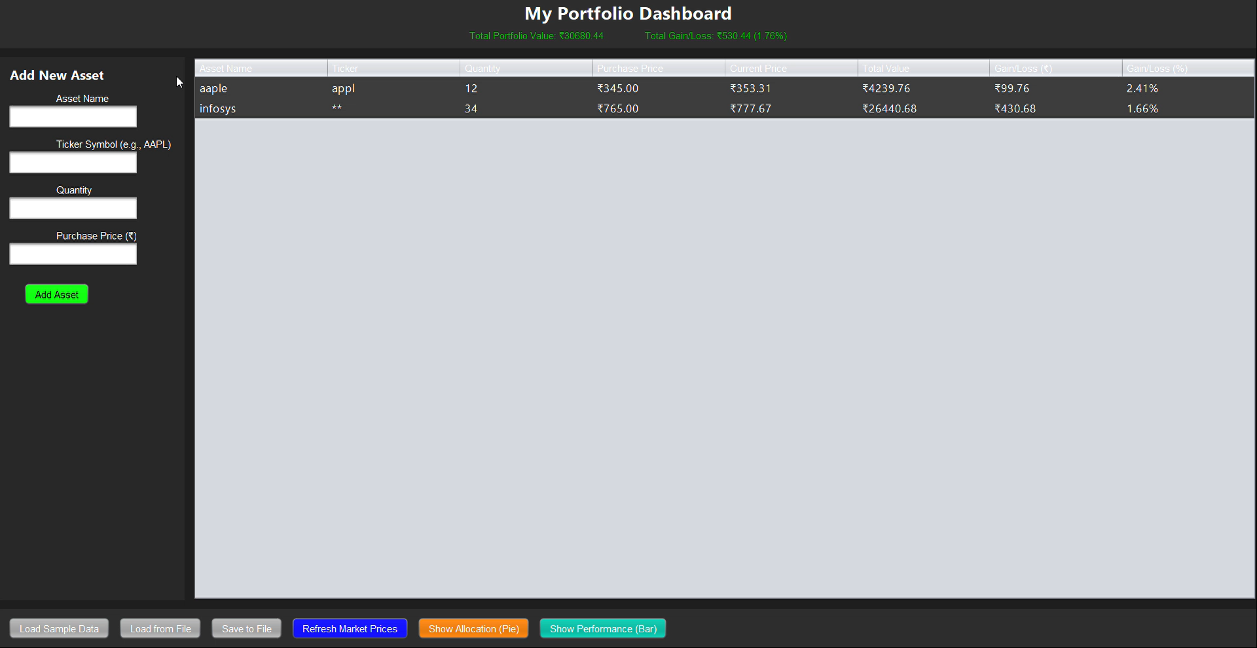
SNAPSHOTS
Notes:
Add New Asset (Left Panel): This is a simple form where you can add new investments to your portfolio. You enter the asset's name, its stock ticker symbol (like 'AAPL' for Apple), the quantity you own, and the original price you paid for it.
Portfolio View (Main Table): This large table in the center lists all the assets you have added. For each asset (like Apple and Infosys), it clearly shows:
Quantity (how many you own)
Purchase Price (what you paid)
Current Price (today's market price)
Total Value (Current Price x Quantity)
Gain/Loss (how much money you've made or lost, shown in both ₹ and %)
Overall Summary (Top): Above the table, you see the most important numbers: your Total Portfolio Value and your Total Gain/Loss combined from all your assets.
Control Panel (Bottom Buttons): This bar lets you control the application:
Load/Save: You can load sample data, load your saved portfolio from a file, or save your current portfolio.
Refresh Market Prices: This button updates the "Current Price" for all your assets to give you real-time data.
Show Charts: These buttons open the "Allocation (Pie)" and "Performance (Bar)" charts you showed me earlier

Slide 12
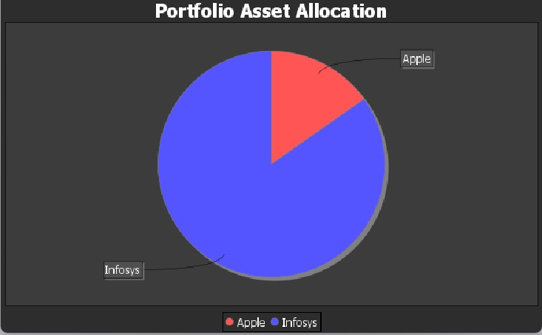
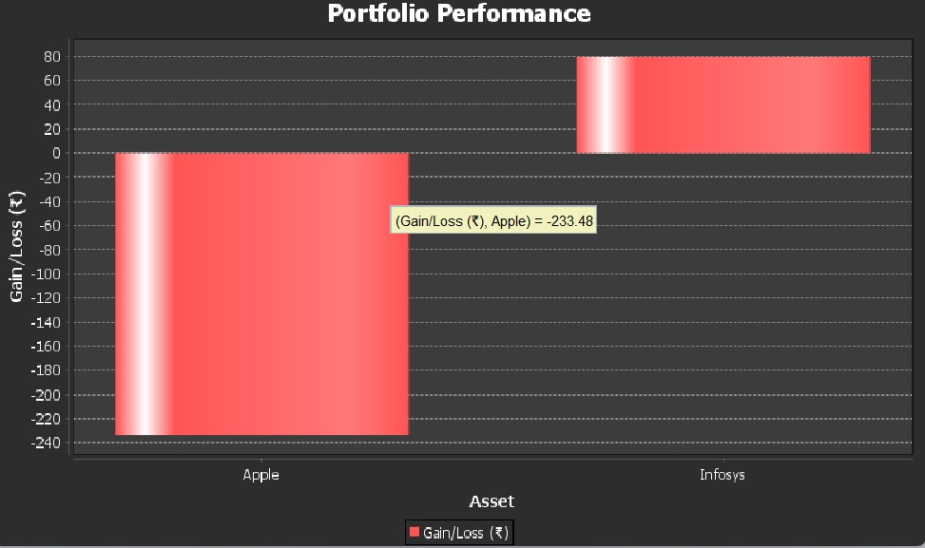
SNAPSHOTS…!
Pie Chart | Bar Chart
1. Best for showing parts of a whole (like percentages). | 1. Best for comparing values against each other.
2. Clearly shows which category is the biggest or smallest piece of the total. | 2. Makes it easy to rank categories from highest to lowest.
Notes:
Left (Portfolio Asset Allocation): This pie chart shows how your money is divided. The large blue section shows that most of your investment is in "Infosys," while the smaller red section shows you have less invested in "Apple."
Right (Portfolio Performance): This bar chart shows your profit and loss for each asset. The large, negative red bar for "Apple" means you have a significant loss on that stock. The smaller, positive red bar for "Infosys" shows you have a gain on that investment.

Slide 13
CORE FEATURES & PROJECT ANALYSIS:
Key Application Features
Add New Asset: Users can add new assets by specifying Name, Symbol, Quantity, and Price.
Table View: A clear, consolidated table provides a complete summary of the portfolio.
Real-Time Gain/Loss Calculation: The system automatically calculates and displays real-time profit or loss.(From the random data )
Data Loading and Saving: Includes options to load and save portfolio data for persistence.
Refresh Button: A dedicated button to fetch the latest market prices on demand.
Dashboard UI: A clean, modern, and interactive user interface for a simple user experience.
Risk & Privacy Analysis
Privacy Impact Assessment (PIA) Diagram: We have developed a PIA flowchart that maps the complete data lifecycle—from collection to deletion—to identify and mitigate any privacy risks.
Risk Analysis Bar Graph: This graph visually compares the "Initial Risk" (e.g., unauthorized access) versus the "Mitigated Risk," demonstrating how our security protocols effectively reduce all high-level threats to a "Low" severity.
Notes:
This slide outlines your application's main functions, which are divided into two categories:
Core App Features: These are the functions the user directly interacts with. They include:
Adding new assets (name, symbol, quantity, price).
Viewing the portfolio in a clear table.
Seeing real-time profit/loss calculations.
Loading and saving the portfolio data.
A "Refresh" button to get the latest market prices.
A clean and simple UI (User Interface).
Risk & Privacy Analysis: This is a more technical analysis about your project. It's not a user-facing feature but part of your development documentation. It includes:
A Privacy Impact Assessment (PIA) diagram to map data handling and identify privacy risks.
A Risk Analysis Bar Graph to prove that your security protocols (like passwords or encryption) effectively reduce threats from a "High" to a "Low" level

Slide 14
IMPLEMENTATION:
UI Design : We designed the interface using JavaSwing for a modern, responsive layout.
Data Table: Implemented a TableView to display the portfolio with real-time gain/loss computation.
File Management: Enabled data persistence by loading and saving the portfolio to local files.
Dynamic Updates: Integrated a refresh function to fetch current market prices and update total values.
Testing & Validation: Conducted thorough testing to verify the accuracy of all calculations and data display.

Slide 15
ADVANTAGES AND DISADVANTAGES:
Advantages 👍 | Disadvantages 👎
Centralized Tracking: Consolidates all assets into one automated dashboard. | You have to type in all your investment details to start.
Time Efficiency: Simplifies and streamlines financial management. | If you type a wrong number, all the calculations will be wrong.
Informed Decisions: Enables transparent, data-driven investment choices. | Storing all your financial info in one app could be a security risk.
User-Friendly: Intuitive design suitable for both beginners and professionals. | Advanced features or apps might cost money to use.
Real-Time Data: Instantly displays current portfolio value and performance. | Can be confusing if you are not comfortable with computers.
Centralized Tracking: Consolidates all assets into one automated dashboard. | May not connect to your bank, so you still have to update things yourself.

Slide 16
CONCLUSION:
In summary, this project successfully delivers a powerful and streamlined solution, transforming the complex task of tracking personal investments into a simple, automated experience. By providing accurate, real-time gain/loss analytics through a clean and interactive dashboard, our application empowers users to move from passive tracking to active, informed financial decision-making.
The robust foundation we have built not only meets all of our initial objectives but is also fully prepared for significant future enhancements. The path is clear for integrating AI-based predictive insights and seamless cloud synchronization, evolving this tool into an even more comprehensive and intelligent platform.

Slide 17
REFERENCES
Here is the updated "References" list with the "Key Libraries" section removed:
References
Core Language & Platform:
Oracle Corporation. (2021). Java SE Development Kit 17. Retrieved from oracle.com
Oracle Corporation. (2021). Java Swing (Java SE 17). Retrieved from docs.oracle.com
Development Tools:
Microsoft Corporation. (2025). Visual Studio Code. Retrieved from code.visualstudio.com
Apache Software Foundation. Apache Maven. Retrieved from maven.apache.org

Slide 18


